Slide 1
Lecture 8
Timer and Counter
Shakran Hayat
Pi-Labs Bangladesh Ltd.

Slide 3
What is Timer?
We use timers every day - the most simple one can be found on your wrist. A simple clock will time the seconds, minutes and hours elapsed in a given day. AVR timers do a similar job, measuring a given time interval.
The AVR timers are very useful as they can run asynchronous to the main AVR core. The timers are separate circuits on the AVR chip which can run independent of the main program (interacting via the some registers and the timer interrupts). Timers can be configured to produce outputs directly to pre-determined pins, reducing the processing load on the AVR core.
A timer in simplest term is a register.

Slide 4
Timer
ATmega16 has three timers:
Timer 0 and Timer 2 is a 8-bit timer. So capable of holding value within 0-255.
Timer 1 is a 16-bit timer. So capable of holding value within 0-65535.

Slide 5
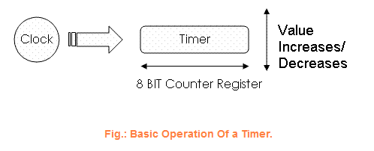
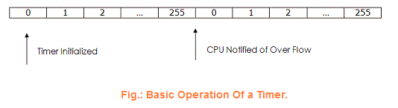
Timer’s Time
Register’s value increases/decreases automatically at a predefined rate (supplied by user). That mean, like mcu, the timer requires a clock in order to function. As each clock pulse increments the timer's counter by one.
Timer Resolution = (1 / Input Frequency) Timer Resolution = (1 / 100) Timer Resolution = .01 seconds
So for TIMER0 to count up-to 256 cycle it will take:
(256 x .01) = 2.56 seconds
That mean, Time period = 2.56 seconds
Exercise: How you’ll make 1s time period with 100Hz input frequency?

Slide 6


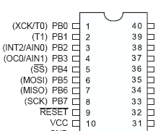
Timer’s Register Output Compare Register – OCR0 and Timer/Counter Register – TCNT0
The Output Compare Register contains an 8-bit value that is continuously compared with the counter value (TCNT0). A match can be used to generate an output compare interrupt, or to generate a waveform output on the OC0 pin.

Slide 7

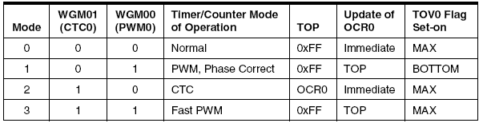
Timer’s Register Timer / Counter Control Register - TCCR0
▪ Bit 6, 3 – WGM01:0: Waveform Generation Mode:

Slide 8
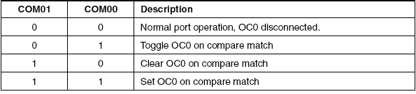
Timer’s Register Timer / Counter Control Register - TCCR0
▪ Bit 5:4 – COM01:0: Compare Match Output Mode:
Note: However, note that the Data Direction Register (DDR) bit corresponding to the OC0 pin must be SET in order to enable the output.

Slide 9
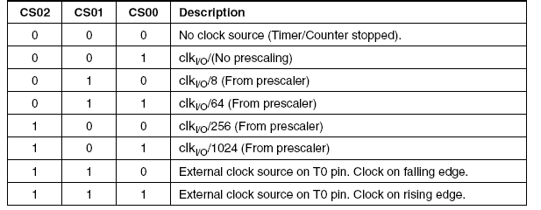
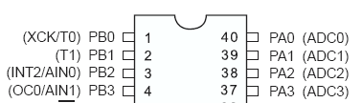
Timer’s Register Timer / Counter Control Register - TCCR0
▪ Bit 2:0 – CS02:0: Clock Select:

Slide 10


Timer’s Register Timer / Counter Interrupt Mask Register - TIMSK and Interrupt Flag Register - TIFR
▪ Bit 1 – OCIE0: Timer/Counter0 Output Compare Match Interrupt Enable.
▪ Bit 0 – TOIE0: Timer/Counter0 Overflow Interrupt Enable.

Slide 11
Timer’s Law
Desired Value = (“Time in second” x “MCU Frequency in Hz”)
(Prescaler)
Now suppose you want to make a 1ms timer.
So,
Time = .001 s
MCU freq = 8000000Hz
Prescaler = 64 (assume)

Slide 12
Timer’s Law
Desired Value = (“Time in second” x “MCU Frequency in Hz”)
(Prescaler)
Now suppose you want to make a 1ms timer.
So,
Time = .001 s
MCU freq = 8000000Hz
Prescaler = 64 (assume)
Desired Value = (.001 x 8000000)
64
= 125
So put, OCR0 = 125.
Or you can do this, TCNT0 = 255 – 125 = 130.

Slide 13
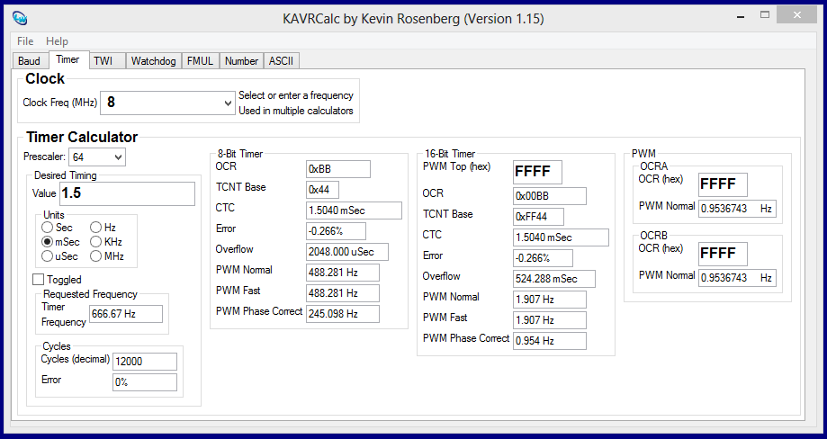
Timer Calculator

Slide 14
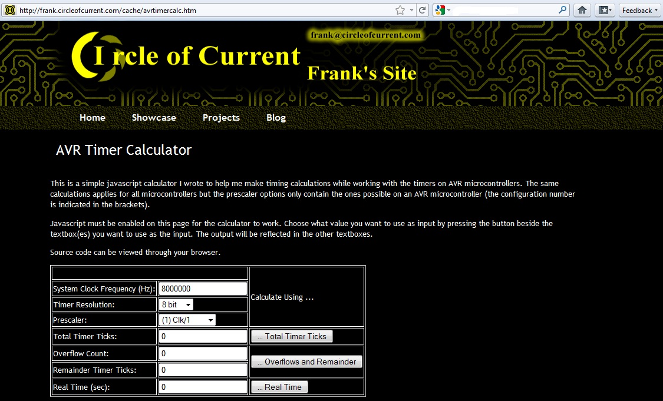
Timer Calculator
http://eleccelerator.com/avr-timer-calculator/

Slide 15
CODE

Slide 16
CODE-1
Lets Do Coding……

Slide 17
CODE-2
Lets Do Coding……

